Slide 1
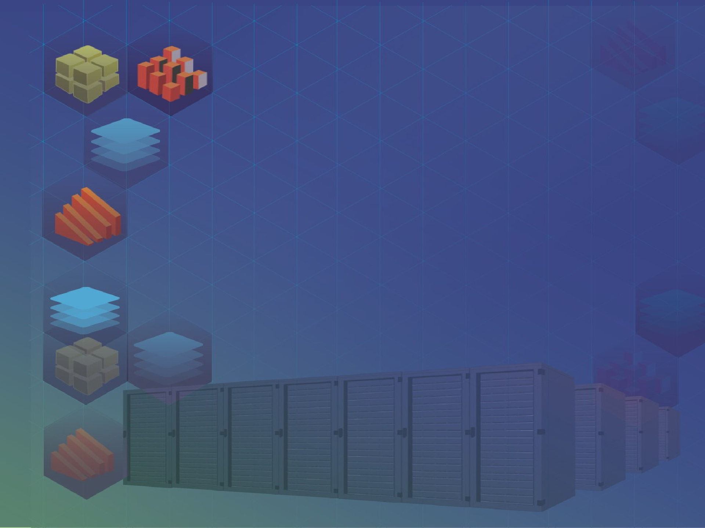
Data Management Using Microsoft SQL Server
SQL
Server
2012
Session: 1
Introduction to the Web
Session: 1
RDBMS Concepts

Slide 2

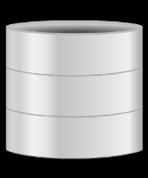

SQL
Server
2012
SQL
Server
2012
Explain the concept of data and database
Describe the approaches to data management
Define a Database Management System (DBMS) and list its benefits
Explain the different database models
Define and explain RDBMS
Describe entities and tables and list the characteristics of tables
List the differences between a DBMS and an RDBMS
2

Slide 3

SQL
Server
2012
SQL
Server
2012
Organizations often maintain large amounts of data, which are generated as a result of day-to-day operations.
A database:
is an organized form of such data.
may consist of one or more related data items called records.
is a data collection to which different questions can be asked.
For example,
'What are the phone numbers and addresses of the five nearest post offices?'
or
'Do we have any books in our library that deal with health food?'
3

Slide 4



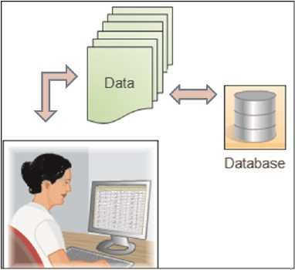
SQL
Server
2012
SQL
Server
2012
When this data is gathered and analyzed, it yields information. Intelligent
interpretation of data yields information.
Information helps to foresee and plan events.
A database is an organized collection of data such that its contents can be easily accessed, managed, and updated.
Following figure illustrates the concept of a database:
A phone book is a database consisting of names, addresses, and telephone numbers.
4

Slide 5

SQL
Server
2012
SQL
Server
2012
Data management deals with managing large amount of information, which
involves:
the storage of information
the provision of mechanisms for the manipulation of information
providing safety of information stored under various circumstances
The two different approaches of managing data are as follows:
File-based systems
Database systems
5

Slide 6

SQL
Server
2012
SQL
Server
2012
In a file-based systems data is stored in discrete files and a collection of such files is
stored on a computer.
Rows in the table were called records and columns were called fields. An example of the file-based system is illustrated in the following table:
First Name | Last Name | Address | Phone
Eric | David | ericd@eff.org | 213-456-0987
Selena | Sol | selena@eff.org | 987-765-4321
Jordan | Lim | nadroj@otherdomain.com | 222-3456-123
6

Slide 7
SQL
Server
2012
SQL
Server
2012
Data redundancy and inconsistency
Unanticipated queries
Data isolation
Concurrent access anomalies
Security problems
Integrity problems
7

Slide 8

SQL
Server
2012
SQL
Server
2012
Database Systems evolved in the late 1960s to address common issues in
applications handling large volumes of data, which are also data intensive.
At any point of time, data can be retrieved from the database, added, and searched based on some criteria in these databases.
Data stored in this form is not permanent. Records in such manual files can only be
maintained for a few months or few years.

Slide 9
SQL
Server
2012
SQL
Server
2012
The amount of redundancy in the stored data can be reduced
No more inconsistencies in data The stored data can be shared
Standards can be set and followed
Data Integrity can be maintained
Security of data can be implemented

Slide 10
SQL
Server
2012
SQL
Server
2012
A DBMS is a collection of related records and a set of programs that access and
manipulate these records and enables the user to enter, store, and manage data.
A database is a collection of interrelated data, and a DBMS is a set of programs used to add or modify this data.
Automated teller machines
Computerized parts inventory systems
Computerized library systems
Flight reservation systems

Slide 11
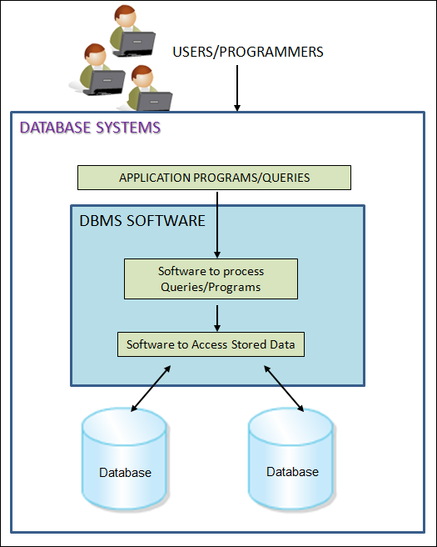
SQL
Server
2012
SQL
Server
2012
Following figure illustrates a database system:

Slide 12
SQL
Server
2012
SQL
Server
2012
A DBMS is responsible for processing data and converting it into information.
These reports are the source of information, which is, processed data.

Slide 13
SQL
Server
2012
SQL
Server
2012
Data storage
Data definition Data manipulation
Data security and integrity
Data recovery and concurrency
Performance optimization Multi-user access control
Database access languages and Application Programming Interfaces (APIs)

Slide 14
SQL
Server
2012
SQL
Server
2012
Databases can be differentiated based on functions and model of the data.
The analysis and design of data models has been the basis of the evolution of databases.
Flat-file Data
Model
Hierarchical
Data Model
Network
Data Model
Relational
Data Model

Slide 15
SQL
Server
2012
SQL
Server
2012
In this model, the database consists of only one table or file.
This model cannot handle very complex data. It can cause redundancy when data is repeated more than once.
Following table depicts the structure of a flat file database:
Roll Number | First Name | Last Name | Subject | Marks
45 | Jones | Bill | Maths | 84
45 | Jones | Bill | Science | 75
50 | Mary | Mathew | Science | 80

Slide 16
SQL
Server
2012
SQL
Server
2012
In this model, different records are inter-related through hierarchical or tree-like
structures.
A parent record can have several children, but a child can have only one parent.
Windows Registry is an example of a hierarchical database storing configuration
settings and options on Microsoft Windows operating systems.

Slide 17
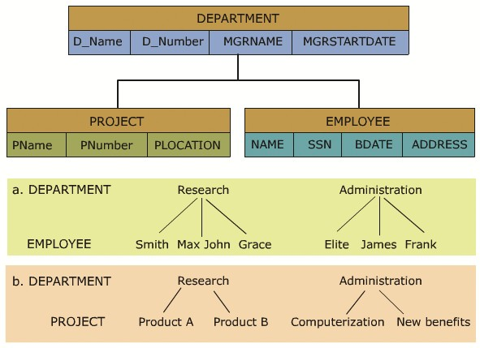
SQL
Server
2012
SQL
Server
2012
Following figure illustrates an example of a hierarchical representation:
Within the hierarchical model, Department is perceived as the parent of the segment.
The tables, Project and Employee, are children.
A path that traces the parent segments beginning from the left, defines the tree.
This ordered sequencing of segments tracing the hierarchical structure is called the hierarchical path.

Slide 18
SQL
Server
2012
SQL
Server
2012
The advantages of a hierarchical model are as follows:
Data is held in a common database so data sharing becomes easier, and security is provided and enforced by a DBMS.
Data independence is provided by a DBMS, which reduces the effort and costs in maintaining the program.
This model is very efficient when a database contains a large volume of data.
For example, a bank's customer account system fits the hierarchical model well because each customer's account is subject to a number of transactions.

Slide 19


SQL
Server
2012
SQL
Server
2012
This model is similar to the Hierarchical Data Model. It is actually a subset of the network model.
The set theory of the network model does not use a single-parent tree hierarchy. It allows a child to have more than one parent. Thus, the records are physically linked through linked-lists.
A portion of the database as seen by the application's programs that actually produce the desired information from the data contained in the database is called sub-schema.

Slide 20
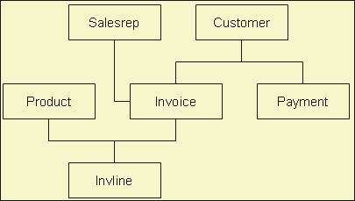
SQL
Server
2012
SQL
Server
2012
The network model shown in the following figure illustrates a series of one-to-many relationships:
A sales representative may write many Invoice tickets, but each Invoice is written by
a single Sales representative (Salesrep).
A Customer might make purchases on different occasions.
A Customer may have many Invoice tickets, but each Invoice belongs only to a single customer.
An Invoice ticket may have many Invoice lines (Invline), but each Invline is found on a single Invoice ticket.
A Product may appear in several different Invline, but each Invline contains only a single Product.

Slide 21
SQL
Server
2012
The components of the language used with network models are as follows:
Data Definition Language (DDL)
Used to create and remove databases and database objects. It enables the database administrator to define the schema components.
Sub-schema DDL
Enables the database administrator to define the database components.
Data Manipulation Language (DML)
Used to insert, retrieve, and modify database information.
Data Control Language (DCL)
Used to administer permissions on the databases and database
objects.
SQL
Server
2012

Slide 22
SQL
Server
2012
SQL
Server
2012
The advantages of such a structure are specified as follows:
 | Relationships are easier to implement in the network database model than in the
 | hierarchical model.
This model enforces database integrity.
This model achieves sufficient data independence.
The disadvantages are specified as follows:
The databases in this model are difficult to design.
The programmer has to be familiar with the internal structures to access the database. The model provides a navigational data access environment.
This model is difficult to implement and maintain.
Computer programmers, rather than end users, utilize this model.

Slide 23

SQL
Server
2012
SQL
Server
2012
As the information needs grew and more sophisticated databases and applications were required, database design, management, and use became too cumbersome.
The term 'Relation' is derived from the set theory of mathematics. In the Relational
Model, unlike the Hierarchical and Network models, there are no physical links.
Operators are provided for operating on rows in tables. This model represents the database as a collection of relations.

Slide 24
SQL
Server
2012
SQL
Server
2012
A row is called a tuple, a column, an attribute, and the table is called a relation.
Several attributes can belong to the same domain.
The number of tuples determines the cardinality of the relation.

Slide 25
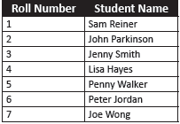
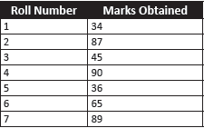
SQL
Server
2012
SQL
Server
2012
In order to understand the relational model, consider the following Students and
Marks tables:
Students Table
Marks Table
The Students table displays the Roll Number and the Student Name, and the
Marks table displays the Roll Number and Marks obtained by the students.
To locate students with marks above 40:
First, locate the roll numbers of those who have scored above 50 from the
Marks table.
Second, their names have to be located in the Students table by matching the roll number.

Slide 26
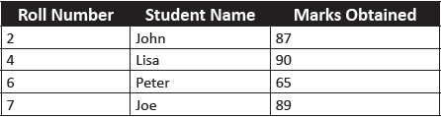
SQL
Server
2012
SQL
Server
2012
The result is displayed as shown in the following table:
It was possible to get this information because of two facts:
First, there is a column common to both the tables - Roll Number.
 | Second, based on this column, the records from the two different tables could
 | be matched and the required information could be obtained.
In a relational model, data is stored in tables.
A table in a database has a unique name that identifies its contents.
Each table can be defined as an intersection of rows and columns.

Slide 27


SQL
Server
2012
SQL
Server
2012
Advantages of the relational model
Gives the programmer time to concentrate on the logical view of the
database rather than being bothered about the physical view.
Provides querying flexibility and hence the popularity of the relational databases.
Easy to handle model to the extent that even untrained people find it easy to generate handy reports and queries, without giving much thought to the need to design a proper database.
Disadvantages of the relational model
Hides all the complexities of the system and hence it tends to be slower
than the other database systems.

Slide 28


SQL
Server
2012
SQL
Server
2012
Relational Model is an attempt to simplify database structures.
An RDBMS is a software program that helps to create, maintain, and manipulate a relational database.
Tables are related in a relational database, allowing adequate data to be retrieved in a single query (although the desired data may exist in more than one table).

Slide 29

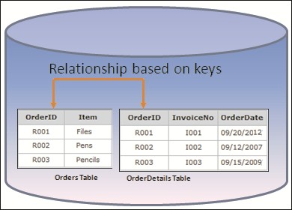
SQL
Server
2012
SQL
Server
2012
Following figure shows two tables related to one another through a common key (data value) in a relational database:
Thus, a relational database is a database structured on the relational model.
Basic characteristic of a relational model is that in a relational model, data is stored in relations.

Slide 30

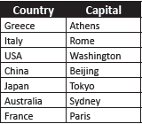
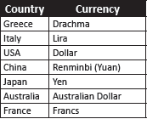
SQL
Server
2012
SQL
Server
2012
Following are the Capitals and Currency tables showing a list of countries and their capitals, and the countries and the local currencies used by them respectively:
Capitals Table
Currency Table
Both the tables have a common column, that is, the Country column.
Now, to display the information about the currency used in Rome, first find the name
of the country to which Rome belongs from table Capitals.
Next, that country should be looked up in table Currency to find out the currency.
It is possible to get this information because it is possible to establish a relation between the two tables through a common column called Country.

Slide 31
SQL
Server
2012
SQL
Server
2012
There are certain terms that are mostly used in an RDBMS. These are described as follows:
Data is presented as a collection of relations.
Each relation is depicted as a table.
Columns are attributes.
Rows ('tuples') represent entities.
Every table has a set of attributes that are taken together as a 'key' (technically, a 'superkey'), which uniquely identifies each entity.

Slide 32
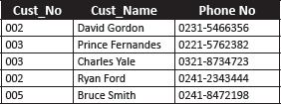
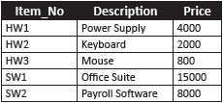
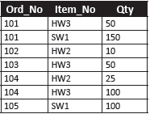
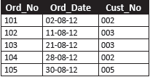
SQL
Server
2012
SQL
Server
2012
Consider the scenario of a company maintaining customer and order information for products being sold and customer-order details for a specific month, say, August.
The following tables are used to illustrate this scenario:
Customer
Items
Order_August
Order_Details

Slide 33
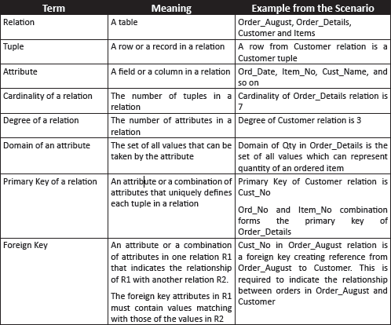
SQL
Server
2012
SQL
Server
2012
Following table lists the terms related to tables:

Slide 34


SQL
Server
2012
SQL
Server
2012
Many persons are involved in the design, use, and maintenance of a large database
with a few hundred users.
Database Administrator (DBA)
Collects the information that will be stored in the database
Responsible for authorizing access to the database
Coordinating and monitoring its use
Acquiring software and hardware resources as needed
Accountable for problems such as breach of security or poor
system response time
Database Designer
Responsible for identifying the data to be stored in the database
Choosing appropriate structures to represent and store this data
Communicate with all prospective database users, in order to
understand their requirements
To come up with a design that meets the requirements

Slide 35
SQL
Server
2012
SQL
Server
2012
System Analysts and Application Programmers
Determine the requirements of end users
Develop specifications for pre-determined transactions that meet these requirements
Implement these specifications as programs
Test, debug, document, and maintain these pre-determined transactions
Design, development, and operation of the DBMS software and system environment
DBMS Designers and Implementers
Design and implement the DBMS modules and interfaces as a software package.
End User
The end user invokes an application to interact with the system, or writes
a query for easy retrieval, modification, or deletion of data.

Slide 36

SQL
Server
2012
SQL
Server
2012
An entity is a person, place, thing, object, event, or even a concept, which can be distinctly identified.
Each entity has certain characteristics known as attributes.
A grouping of related entities becomes an entity set. Each entity set is given a name. The name of the entity set reflects the contents.

Slide 37
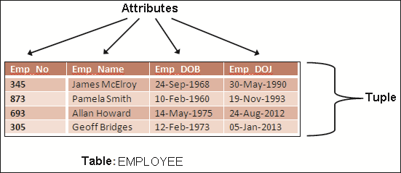
SQL
Server
2012
SQL
Server
2012
The access and manipulation of data is facilitated by the creation of data relationships based on a construct known as a table.
A table is also called a relation. The rows are known as tuples. The columns are known as attributes.
Following figure highlights the characteristics of a table:

Slide 38
SQL
Server
2012
The characteristics of a table are as follows:
A two-dimensional structure composed of rows and columns is perceived as a table.
Each tuple represents a single entity within the entity set. Each column has a distinct name.
Each row/column intersection represents a single data value.
Each table must have a key known as primary key that uniquely identifies each row. All values in a column must conform to the same data format.
Each column has a specific range of values known as the attribute domain. Each row carries information describing one entity occurrence.
The order of the rows and columns is immaterial in a DBMS.
SQL
Server
2012

Slide 39
SQL
Server
2012
SQL
Server
2012
DBMS | RDBMS
It does not need to have data in tabular structure nor does it enforce tabular relationships between data items. | In an RDBMS, tabular structure is a must and table relationships are enforced by the system. These relationships enable the user to apply and manage business rules with minimal coding.
Small amount of data can be stored and retrieved. | An RDBMS can store and retrieve large amount of data.
A DBMS is less secure than an RDBMS. | An RDBMS is more secure than a DBMS.
It is a single user system. | It is a multiuser system.
Most DBMSs do not support client/server architecture. | It supports client/server architecture.
Here, entities are given more importance and there is no relation established among these entities. | Here, a relation is given more importance. Thus, the tables in an RDBMS are dependent and the user can establish various integrity constraints on these tables so that the ultimate data used by the user remains correct.

Slide 40

SQL
Server
2012
SQL
Server
2012
A database is a collection of related data stored in the form of a table.
A data model describes a container for storing data and the process of storing and
retrieving data from that container.
A DBMS is a collection of programs that enables the user to store, modify, and extract information from a database.
A Relational Database Management System (RDBMS) is a suite of software programs for creating, maintaining, modifying, and manipulating a relational database.
A relational database is divided into logical units called tables. These logical units are interrelated to each other within the database.
The main components of an RDBMS are entities and tables.
In an RDBMS, a relation is given more importance, whereas, in case of a DBMS, entities are given more importance and there is no relation established among these entities.

